Slide 1
Classification of Eye Diseases using Hybrid CNN-RNN Model.
Mayuresh Mohan Londhe
X20137265
Research Project Presentation
MSc Data Analytics
16^{h} August 2021

Slide 2
The Problem
Increasing Number of Patients.
Traditional Manual Screening.
Growing Demand and Shortage of Ophthalmologists.
Few Initial Symptoms

Slide 3
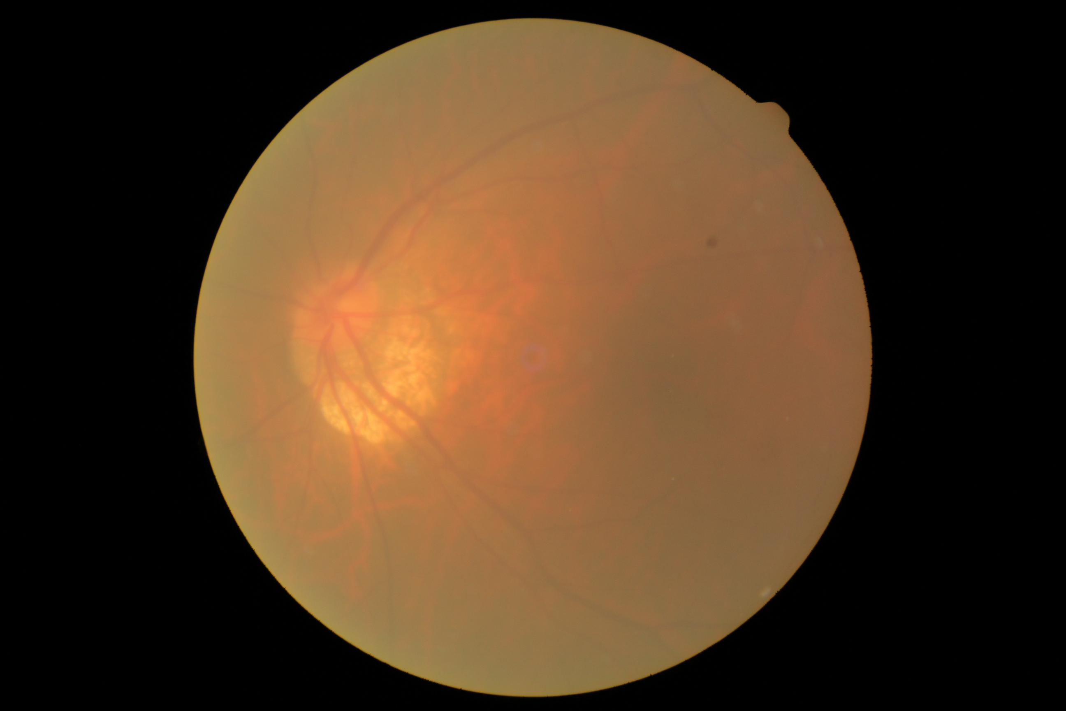
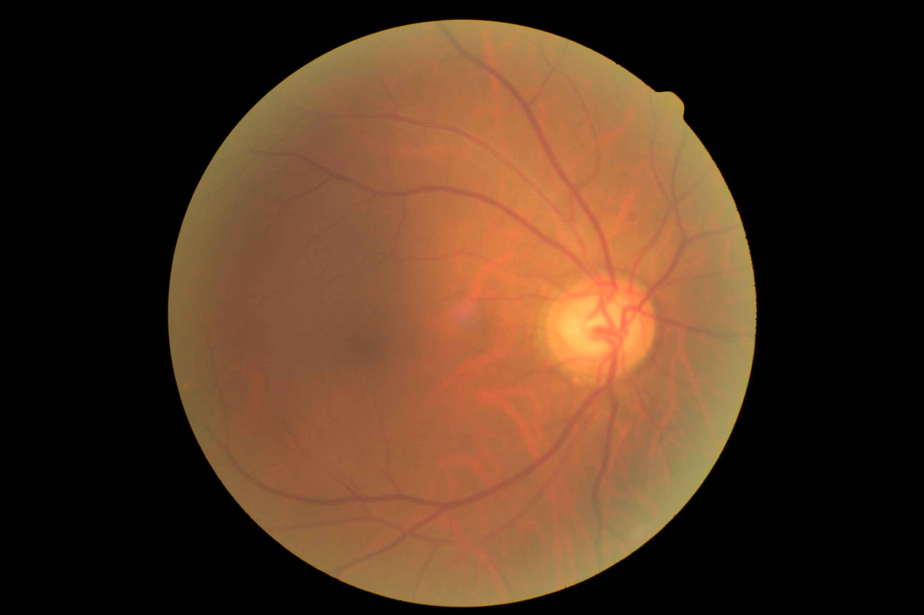
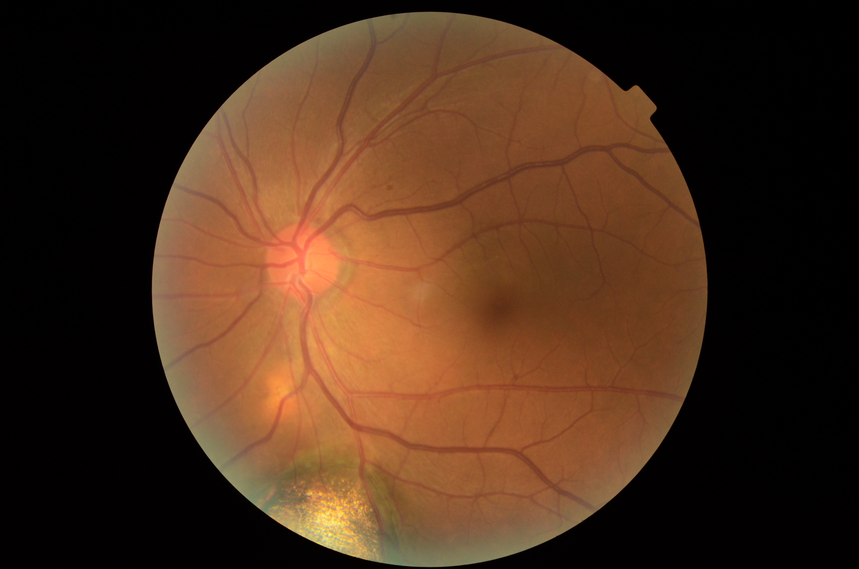
Eye Diseases
Cataracts
Glaucoma
Retina Diseases

Slide 4
Research Gap
Varied Accuracy
Overfitting
Sensitivity
Complexity

Slide 5
Research Question
How well can the Hybrid CNN-RNN models classify the fundus images of the eye into 4 classes Normal, Cataract, Glaucoma, Retina Diseases?

Slide 6
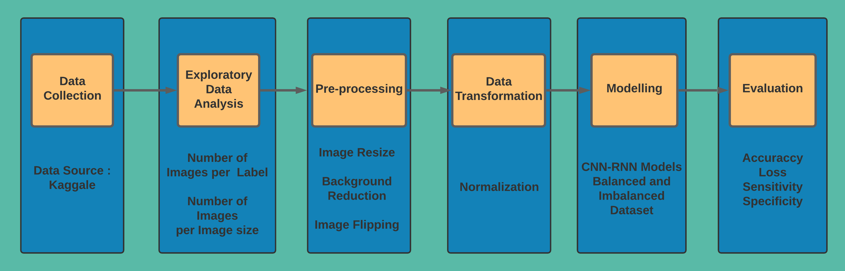
Methodology
Modified Knowledge Discovery in Databases Process.

Slide 7
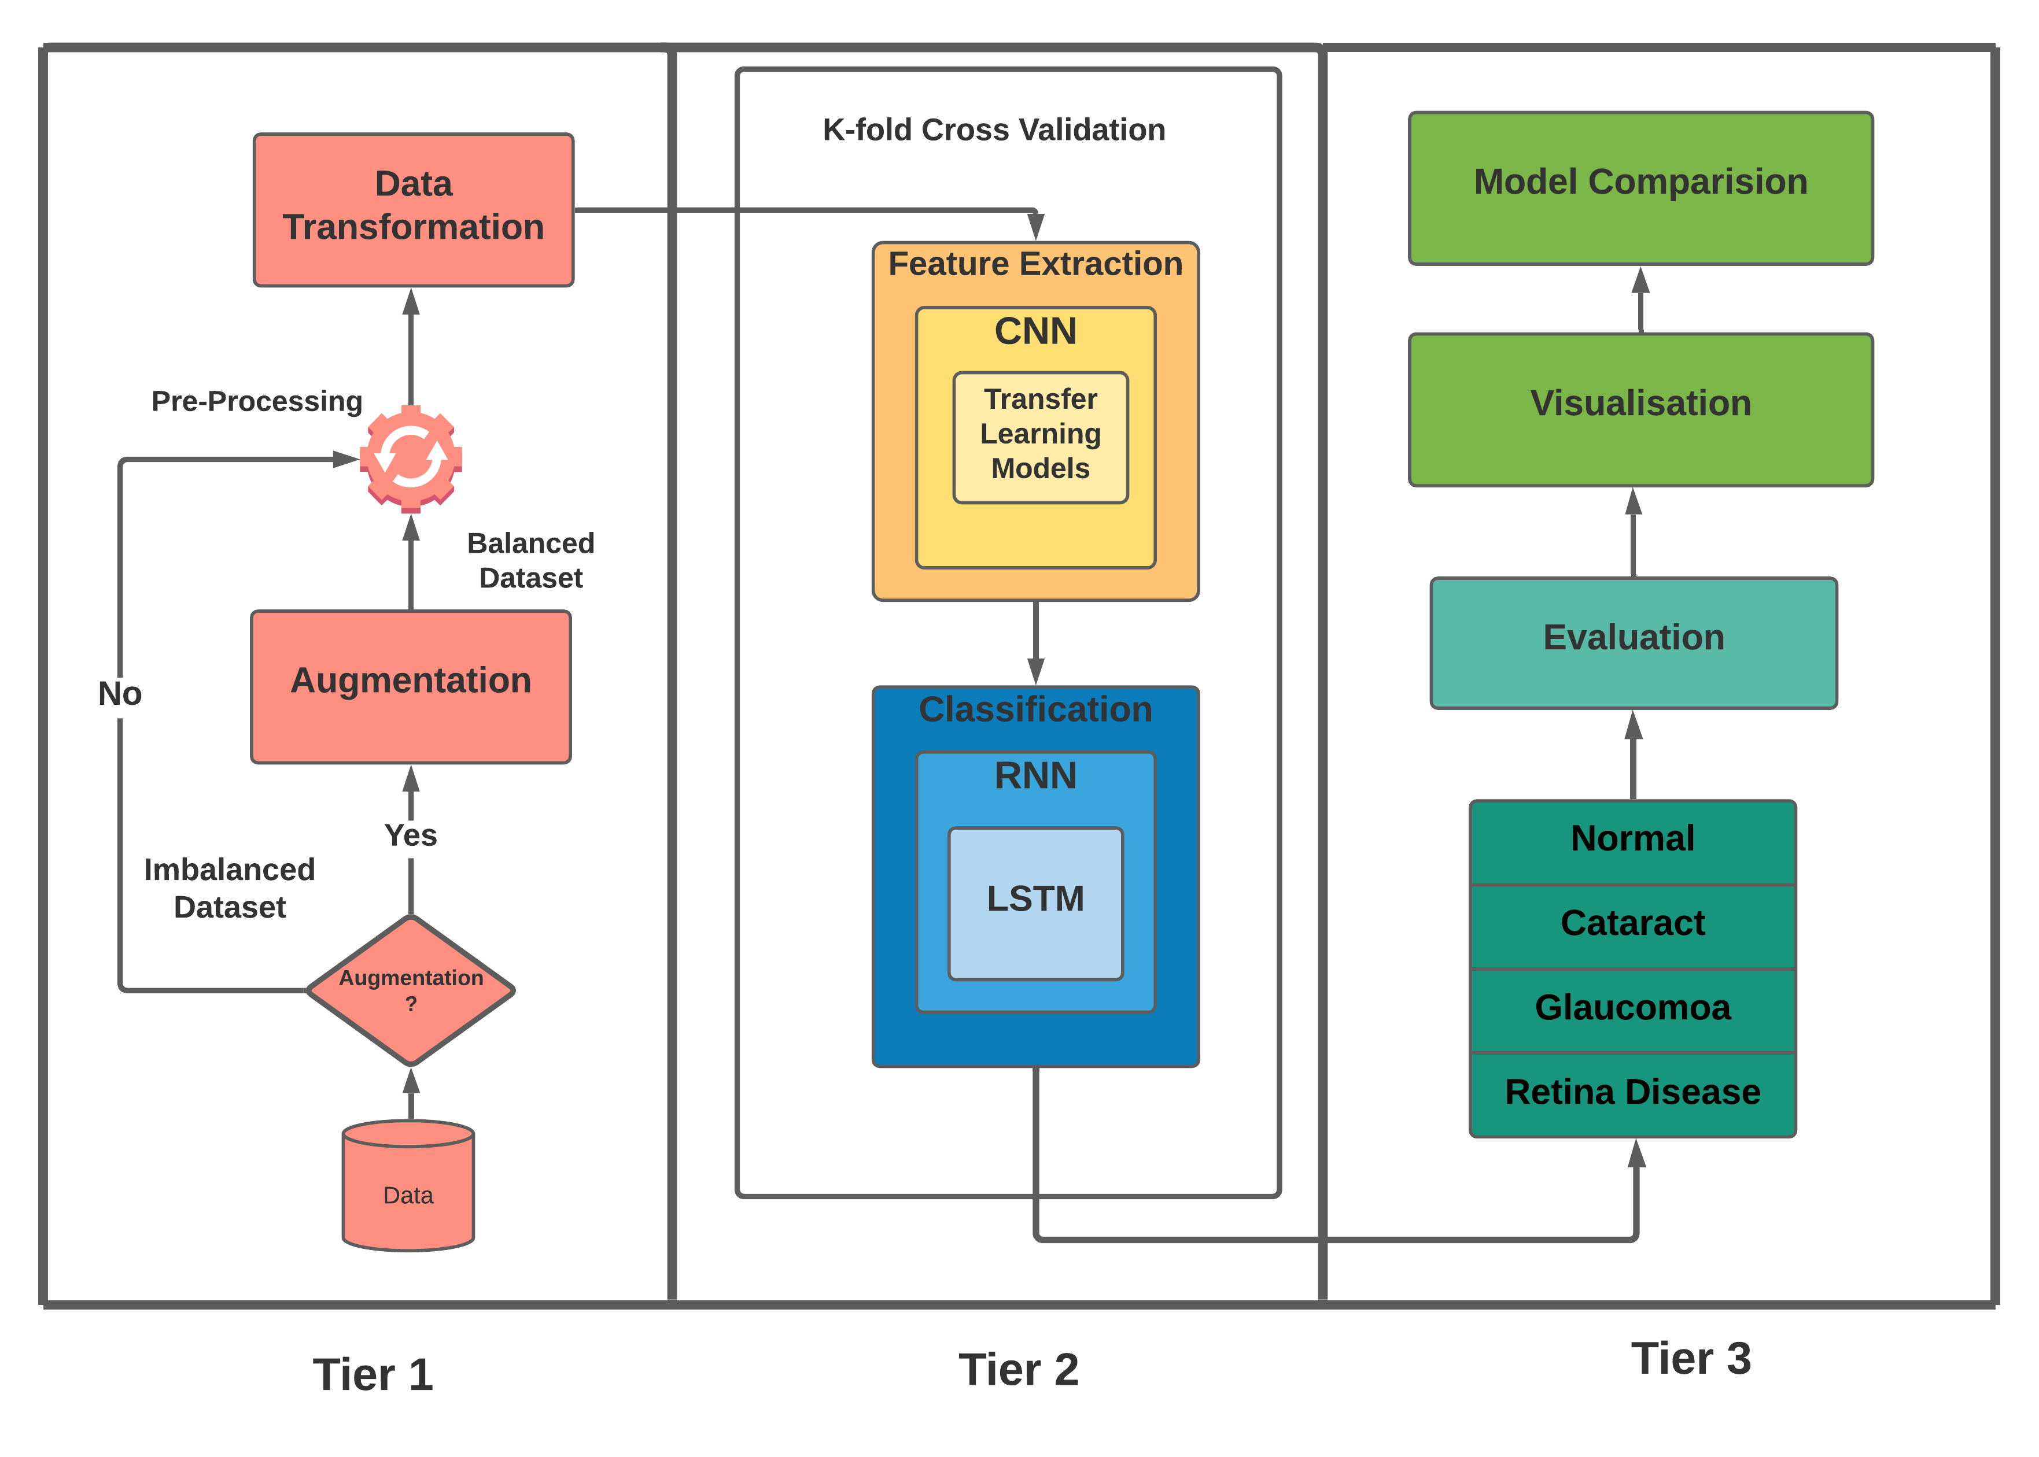
Model Architecture

Slide 8
Results
Comparison of Models over Imbalanced and Balanced Dataset

Slide 9
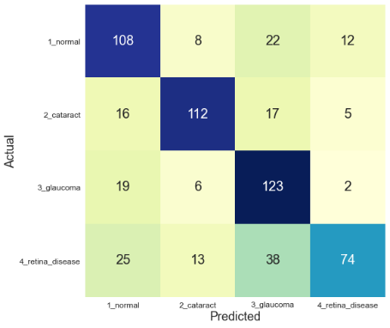
Results
Overall Confusion Matrix for DenseNet16-LSTM (Balanced Dataset)

Slide 10
Results
Model Accuracy Comparison with Similar Researches

Slide 11
Conclusion & Future Work
The hybrid CNN-RNN models implemented on an imbalanced dataset were not able to classify the images with four classes accurately.
The models implemented on balanced dataset performed classification with improved accuracy.
Merging similar datasets.
Feature Segmentation

Slide 12
Thank You.

